Slide 1
31 August 2023
L-13
AGENDA:
Minimum Spanning Tree
Prims Algorithm
Kruskal’s Algorithm

Slide 2
22 Feb 2023
L-13
AGENDA:
Minimum Spanning Tree
Prims Algorithm
Kruskal’s Algorithm
Basic Concepts
Disjoint Set Data Structure

Slide 3
Basic Concepts
Graph: A collection of vertices and edges
A
B
A
B
C
D
C
D
E
E
Undirected Graph
Directed Graph

Slide 4
Basic Concepts
Weighted Graph: A weight(w_{i}) is associated with every edge of graph
A
2
B
5
4
1
C
8
D
5
3
E

Slide 5
Basic Concepts
Acyclic Graph: A graph without cycle
A
B
A
B
C
D
C
D
E
E
Acyclic Graph
Cyclic Graph

Slide 6
Basic Concepts
Connected Graph: A graph in which every pair of vertices has at-least one path
A
B
For pair of vertices (B, C)
Path-1: B→ A → C
C
D
Path-2: B→ D → E → C
Path-3: B→ D → A → C
E

Slide 7
Basic Concepts
Tree: A connected acyclic graph
A
B
A
B
C
D
C
D
Not a Tree
E
E
Tree

Slide 8
Basic Concepts
claim: A tree with n vertices has exactly n-1 edges
A
B
|V| = n = 5
|E| = n-1 = 5-1 = 4
C
D
E
Tree

Slide 9
Basic Concepts
Spanning Tree
A spanning tree of a graph G=<V,E> is a subgraph G’ of G such that
1. G’ is a Tree and
2. G’ spans(covers) all the vertices of G

Slide 10
Basic Concepts
Spanning Tree
A
C
B
D
A
C
A
C
A
C
A
C
ST-1
ST-2
ST-4
ST-3
B
D
B
D
B
D
B
D

Slide 11
Basic Concepts
Weighted Connected Undirected Graph:
A connected undirected graph in which every edge has +ve weight
A
1
C
A
1
C
7
E
4
2
4
2
B
D
10
B
D
3
3

Slide 12
Minimum Spanning Tree
1
A
C
4
2
MST
B
D
3
1
1
A
1
C
A
C
A
C
A
C
4
ST-1
2
4
ST-2
2
4
ST-4
2
ST-3
B
D
B
D
B
D
B
D
3
3
3
Cost
Cost
Cost
Cost
2 + 3 + 4 = 9
1 + 3 + 4 = 8
2 + 3 + 1 = 6
2 + 1 + 4 = 7

Slide 13
Application of MST
Constructing highways or railroads spanning several
cities
You want to supply a set of houses with
Electric Power
Water
Telephone lines
Sewage lines
The concept of MST is used to save the cost

Slide 14
How to find MST of a Graph
MST of a graph can be computed using
Kruskal’s Algorithm(1956)
Prim’s Algorithm(1959)

Slide 15
Disjoint Set Data Structure
Useful to Implement Kruskal’s Algorithm

Slide 16

Disjoint Set Data Structure
Disjoint Set Data Structure
Disjoint Set
Set A
Set B
5
2
4
A and B are disjoint if
$$A∩B=∅$$
1
3
7
9
Set A and Set B are partition of set {1, 2, 3, 4, 5, 7, 9}

Slide 17
Disjoint Set Data Structure
Invented By Michel Fischer in 1964
It is a data structure that stores a collection of disjoint (non-overlapping) sets
it stores a partition of a set into disjoint subsets.
It supports the following operations
Makeset
Union/Merge
Find
Also known as Union Find OR Merge Find Data Structure

Slide 18
Disjoint Set Data Structure
MakeSet(x) : Create a singleton set {x}
void MakeSet(x)
{
parent[x]= x
}
Cost = O(1)

Slide 19
Disjoint Set Data Structure
makeset(1)
makeset(2)
makeset(3)
makeset(4)
makeset(5)
1
2
3
4
5
Element | 1 | 2 | 3 | 4 | 5
Parent | 1 | 2 | 3 | 4 | 5

Slide 20
Disjoint Set Data Structure
findset(x) : returns the parent (representative/leader) of x
int findset(int x)
{
if (x == parent[x])
return x;
return findset(parent[x]);
}

Slide 21
Disjoint Set Data Structure
1
int findset(int x)
{
if (x == parent[x])
return x;
return findset(parent[x]);
}
2
3
8
6
4
5
7
Findset(7) = ?

Slide 22
Disjoint Set Data Structure
1
int findset(int x)
{
if (x == parent[x])
return x;
return findset(parent[x]);
}
2
3
8
6
4
5
7
Findset(7) → findset(parent(7)) =findset(4)

Slide 23
Disjoint Set Data Structure
1
int findset(int x)
{
if (x == parent[x])
return x;
return findset(parent[x]);
}
2
3
8
6
4
5
7
Findset(7) → findset(4)→findset(parent(4))= findset(2)

Slide 24
Disjoint Set Data Structure
1
int findset(int x)
{
if (x == parent[x])
return x;
return findset(parent[x]);
}
2
3
8
6
4
5
7
findset(7) → findset(4)→findset(2)→findset(parent(2)) = findset(1) = 1

Slide 25
Disjoint Set Data Structure
1
findset(7) = 1
3
findset(5) = 1
2
8
6
7 and 5 are member of SAME set
4
5
7
Observation1: If findset(a) = findset(b) then a and b belongs from same set

Slide 26
Disjoint Set Data Structure
5
1
findset(7) = 1
6
9
2
3
findset(10) = 5
10
8
7 and 10 are member of DIFFERENT set
11
4
7
Observation2: If findset(a) $≠$ findset(b) then a and b belongs from Different set

Slide 27
Disjoint Set Data Structure
void union(int a, int b)
{
x = findset(a);
y = findset(b);
if (x != y)
parent[y] = x;
}
5
1
6
9
2
3
10
11
8
4
7
Union(6, 7)

Slide 28
Disjoint Set Data Structure
void union(int a, int b)
{
x = findset(a);
y = findset(b);
if (x != y)
parent[y] = x;
}
x = 5
5
y = 1
1
6
9
2
3
10
11
8
4
7
Union(6, 7)

Slide 29
Disjoint Set Data Structure
void union(int a, int b)
{
x = findset(a);
y = findset(b);
if (x != y)
parent[y] = x;
}
x = 5
5
y = 1
1
6
9
2
3
10
11
8
4
7
Union(6, 7)

Slide 30
Disjoint Set Data Structure
Problem with above Union operation
4
1
3
1
5
5
1
3
3
2
2
1
2
1
Union(1,2)
Union(4,1)
3
Union(3,1)
3
Union(5,2)
2
2
4
4
4
4
5
5
5
Findset = O(n)

Slide 31
Disjoint Set Data Structure
Efficient implementation of Union
Union by Rank ( based on size or depth)
Path compression

Slide 32
Disjoint Set Data Structure
Union by Rank based on size
Logic: The root of Larger size tree becomes the parent of root of smaller size tree
b
Union(a, b)
a
a
b

Slide 33
Disjoint Set Data Structure
1
5
5
3
1
2
6
9
6
9
8
2
3
Union(6, 7)
10
11
4
10
11
8
4
7
Rank = 5
Height = 2
7
Height = 3
Rank = 6
Height = 3

Slide 34
Disjoint Set Data Structure
1
1
1
1
1
2
3
2
3
2
3
2
2
Union(4,2)
5
Union(1,2)
5
3
Union(3,1)
3
Union(5,2)
4
4
4
4
4
5
5
5

Slide 35
Disjoint Set Data Structure
Union by Path Compression
Logic: Flatten the tree when findset(x) is called
1
1
1
2
2
6
5
3
2
Findset(6)
3
3
4
4
4
7
5
7
5
7
8
6
8
6
8

Slide 36
Disjoint Set Data Structure
m = total number of operations(find + union + makeset)
n = total number of makeset operation
Claim 1:
Union by rank gives running time = $θ\left(m\log{n}\right)$
Claim 2:
Union by path compression gives running time = $θ{(mlog}^{∗}n)$
Where $\log^{∗}n$ is the iterated logarithm (inverse of Ackerman functions)

Slide 37
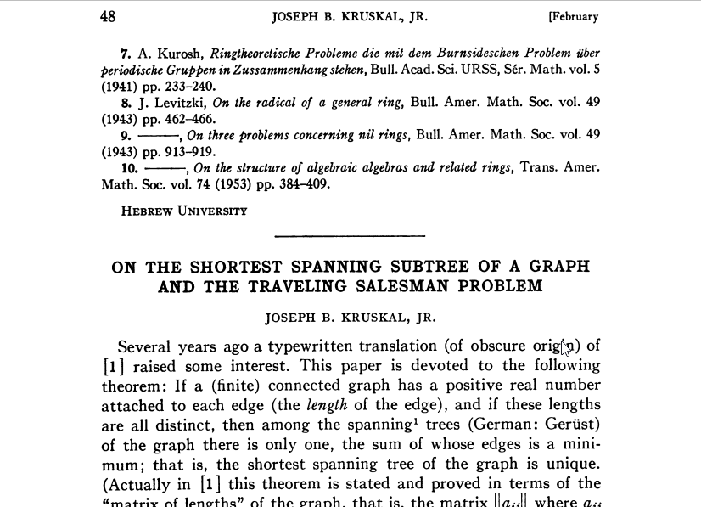
Kruskal’s Algorithm(1956)

Slide 38
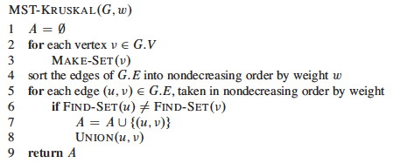
Kruskal’s Algorithm

Slide 39
Kruskal’s Algorithm
S
O
R
T
E
D
Edge | Weight
ab | 1
bc | 2
df | 2
ad | 2
ae | 2
be | 3
ce | 3
eg | 4
ef | 5
fg | 5
de | 6
cg | 6
Finding MST using Kruskal’s Algorithm
b
2
c
1
3
6
3
2
e
4
g
a
6
5
5
2
f
d
2
A = { }

Slide 40
Kruskal’s Algorithm
Findset(a) != Findset(b)
Edge | Weight
ab | 1
bc | 2
df | 2
ad | 2
ae | 2
be | 3
ce | 3
eg | 4
ef | 5
fg | 5
de | 6
cg | 6
b
c
e
g
a
f
d
Number of connected components = 7
A = { }

Slide 41
Kruskal’s Algorithm
Edge | Weight
ab | 1
bc | 2
df | 2
ad | 2
ae | 2
be | 3
ce | 3
eg | 4
ef | 5
fg | 5
de | 6
cg | 6
b
c
1
e
g
a
f
d
Number of connected components = 6
A = {ab }

Slide 42
Kruskal’s Algorithm
Findset(b) != Findset(c)
Edge | Weight
ab | 1
bc | 2
df | 2
ad | 2
ae | 2
be | 3
ce | 3
eg | 4
ef | 5
fg | 5
de | 6
cg | 6
b
c
1
e
g
a
f
d
Number of connected components = 6
A = {ab }

Slide 43
Kruskal’s Algorithm
Edge | Weight
ab | 1
bc | 2
df | 2
ad | 2
ae | 2
be | 3
ce | 3
eg | 4
ef | 5
fg | 5
de | 6
cg | 6
b
2
c
1
e
g
a
f
d
Number of connected components = 5
A = {ab, bc }

Slide 44
Kruskal’s Algorithm
Findset(d) != Findset(f)
Edge | Weight
ab | 1
bc | 2
df | 2
ad | 2
ae | 2
be | 3
ce | 3
eg | 4
ef | 5
fg | 5
de | 6
cg | 6
b
2
c
1
e
g
a
f
d
Number of connected components = 5
A = {ab, bc }

Slide 45
Kruskal’s Algorithm
Edge | Weight
ab | 1
bc | 2
df | 2
ad | 2
ae | 2
be | 3
ce | 3
eg | 4
ef | 5
fg | 5
de | 6
cg | 6
b
2
c
1
e
g
a
f
d
2
Number of connected components = 4
A = {ab, bc, df }

Slide 46
Kruskal’s Algorithm
Findset(a) != Findset(d)
Edge | Weight
ab | 1
bc | 2
df | 2
ad | 2
ae | 2
be | 3
ce | 3
eg | 4
ef | 5
fg | 5
de | 6
cg | 6
b
2
c
1
e
g
a
f
d
2
Number of connected components = 4
A = {ab, bc, df }

Slide 47
Kruskal’s Algorithm
Edge | Weight
ab | 1
bc | 2
df | 2
ad | 2
ae | 2
be | 3
ce | 3
eg | 4
ef | 5
fg | 5
de | 6
cg | 6
b
2
c
1
e
g
a
2
f
d
2
Number of connected components = 3
A = {ab, bc, df, ad }

Slide 48
Kruskal’s Algorithm
Findset(a) != Findset(e)
Edge | Weight
ab | 1
bc | 2
df | 2
ad | 2
ae | 2
be | 3
ce | 3
eg | 4
ef | 5
fg | 5
de | 6
cg | 6
b
2
c
1
e
g
a
2
f
d
2
Number of connected components = 3
A = {ab, bc, df, ad }

Slide 49
Kruskal’s Algorithm
Edge | Weight
ab | 1
bc | 2
df | 2
ad | 2
ae | 2
be | 3
ce | 3
eg | 4
ef | 5
fg | 5
de | 6
cg | 6
b
2
c
1
2
e
g
a
2
f
d
2
Number of connected components = 2
A = {ab, bc, df, ad, ae}

Slide 50
Kruskal’s Algorithm
Findset(b) = Findset(e)
Edge | Weight
ab | 1
bc | 2
df | 2
ad | 2
ae | 2
be | 3
ce | 3
eg | 4
ef | 5
fg | 5
de | 6
cg | 6
b
2
c
1
2
e
g
a
2
f
d
2
Number of connected components = 2
A = {ab, bc, df, ad, ae}

Slide 51
Kruskal’s Algorithm
Findset(c) = Findset(e)
Edge | Weight
ab | 1
bc | 2
df | 2
ad | 2
ae | 2
be | 3
ce | 3
eg | 4
ef | 5
fg | 5
de | 6
cg | 6
b
2
c
1
2
e
g
a
2
f
d
2
Number of connected components = 2
A = {ab, bc, df, ad, ae}

Slide 52
Kruskal’s Algorithm
Findset(e) != Findset(g)
Edge | Weight
ab | 1
bc | 2
df | 2
ad | 2
ae | 2
be | 3
ce | 3
eg | 4
ef | 5
fg | 5
de | 6
cg | 6
b
2
c
1
2
e
g
a
2
f
d
2
Number of connected components = 2
A = {ab, bc, df, ad, ae}

Slide 53
Kruskal’s Algorithm
Edge | Weight
ab | 1
bc | 2
df | 2
ad | 2
ae | 2
be | 3
ce | 3
eg | 4
ef | 5
fg | 5
de | 6
cg | 6
b
2
c
1
2
e
4
g
a
2
f
d
2
Number of connected components = 1
A = {ab, bc, df, ad, ae, eg}

Slide 54
Kruskal’s Algorithm
MST
b
2
c
b
2
c
1
1
3
6
4
g
3
a
2
e
2
e
4
g
a
6
2
5
5
f
2
d
f
2
d
2
Cost = 1 + 2 + 2 + 4 + 2 + 2 = 13
A = {ab, bc, df, ad, ae, eg}

Slide 55
Kruskal’s Algorithm
No. of Make-Set operation = V
No. of Find-Set operation = 2E
No. of Union operation = V – 1
------------------------------
Total Number of operation = 2V + 2E – 1
= O(V + E)

Slide 56

Disjoint Set Data Structure
m = total number of operations(find + union + makeset)
n = total number of makeset operation
Claim 1:
Union by rank gives running time = $θ\left(m\log{n}\right)$

Slide 57
Performance Analysis of Kruskal’s Algorithm
O(1)
O(V)
O(ElogE)
O((V+E)logV)
=
O(ElogE)

Slide 58
Performance Analysis of Kruskal’s Algorithm
Time Complexity of Kruskal’s Algorithm = O(ElogE)
In Dense Graph E = O(V²) hence
Time Complexity of Kruskal’s Algorithm = O(ElogV²)
= O(E*2logV)
= O(E*logV)

